Slide 1
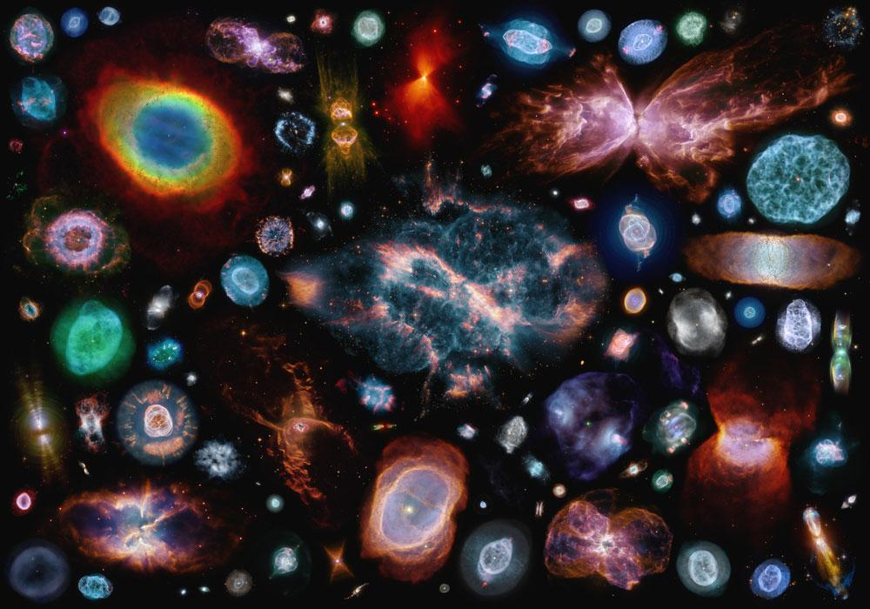
Transfer & Semi-Supervised Learning for Planetary Nebulae Classification
Reproducibility Study +
Joseph Hadidjojo: CV, ML classes
Tung Pham: ML, CV class
Arman Muratbayev: ML classes, current CV student

Slide 2
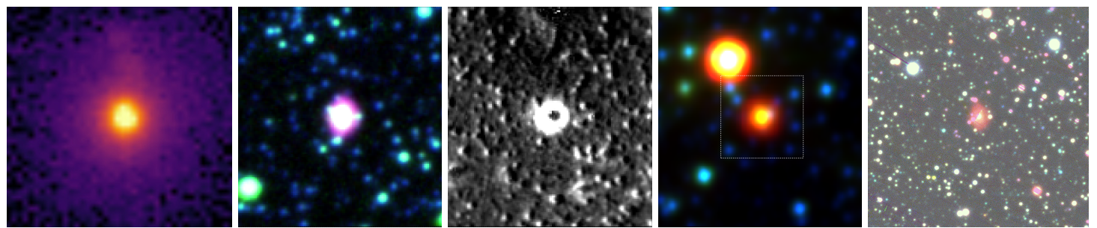
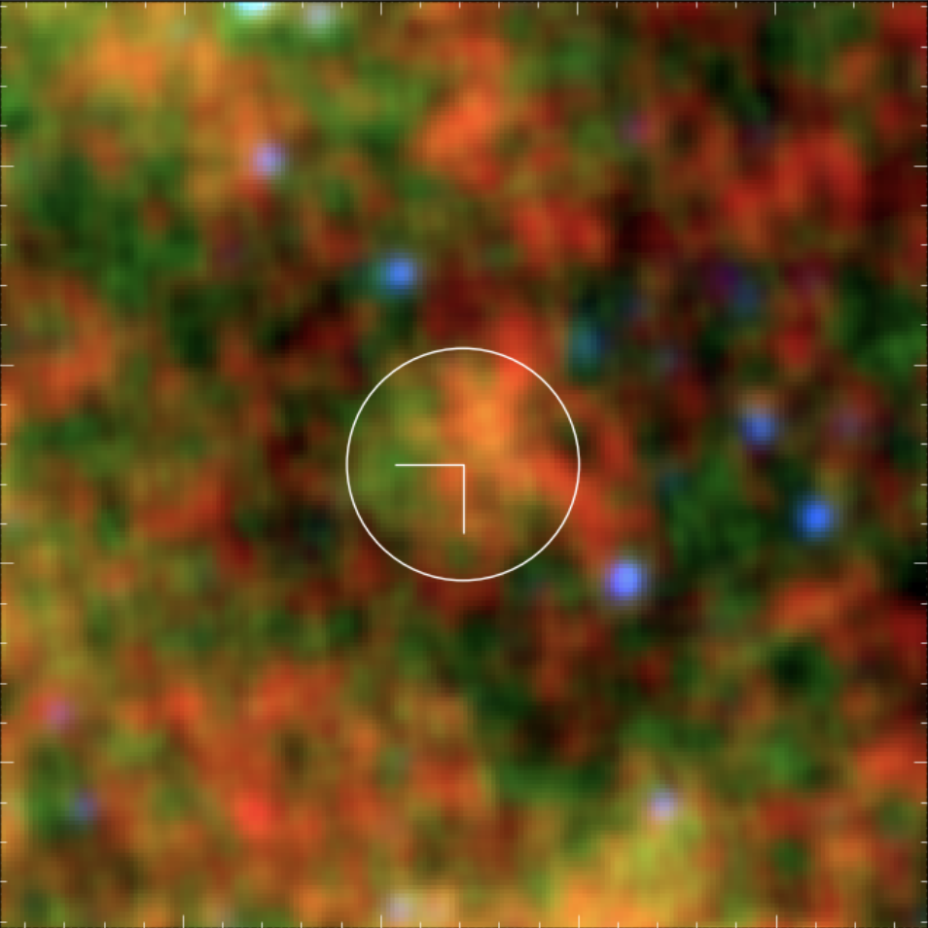
Planetary Nebulae (PNe) Classification
Goal: Given Deep Space Images of Elliptical Objects, classify True PNe or Rejected PNe
Input: 224x224x3 (RGB) Images as Tensor of float64
Output: Binary Classification (True or Rejected)

Slide 3
Learning Tasks: Transfer Learning & Semi-Supervised Learning (SSL)
Two different Learning Tasks:
Transfer Learning (LP-FT) from a large, everyday object source (ImageNet) to a small and very rarely studied target (Planetary Nebulae)

Slide 4
Learning Tasks: Transfer Learning & Semi-Supervised Learning (SSL)
Two different Learning Tasks:
Transfer Learning (LP-FT) from a large, everyday object source (ImageNet) to a small and very rarely studied target (Planetary Nebulae)
SSL (MixMatch) where model learns from few labeled examples, while generating pseudo-labels for many unlabeled data to refine predictions

Slide 5
Learning Tasks: Transfer Learning & Semi-Supervised Learning (SSL)
Two different Learning Tasks:
Transfer Learning (LP-FT) from a large, everyday object source (ImageNet) to a small and very rarely studied target (Planetary Nebulae)
SSL (MixMatch) where model learns from few labeled examples, while generating pseudo-labels for many unlabeled data to refine predictions
Why this matters?
ML: Performance of ImageNet-based TL & MixMatch SSL on a mostly never before seen, “Low-Resolution” dataset
Astrophysics: Motivate Astronomers to more readily explore and adopt ML techniques during deep-space explorations and analysis

Slide 6
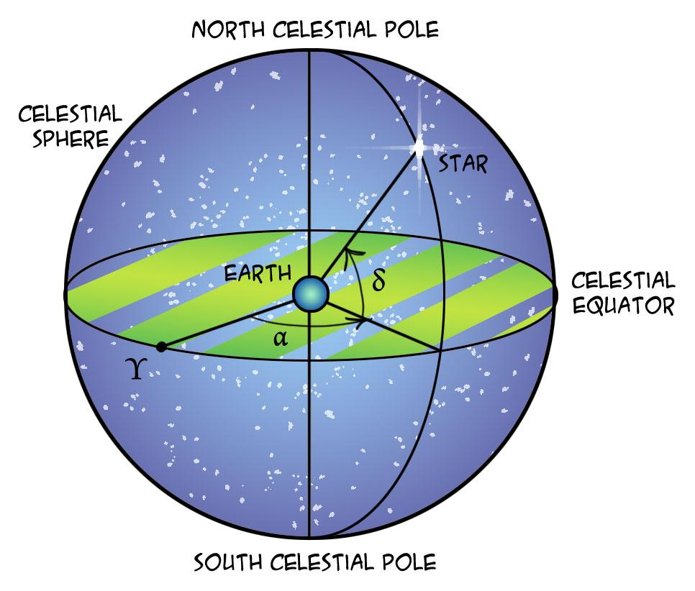
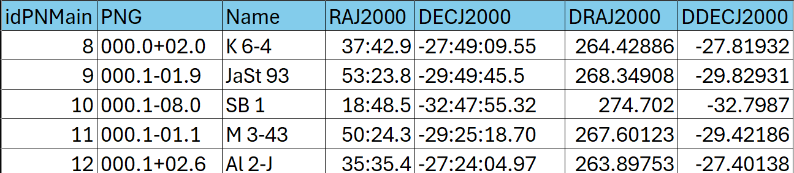
Data and Evaluation
HASH-PN dataset (Parker et al., 2016)
Over 30,000 Images, 5426 Labeled
8/1/1 split of train/val/test
Employ strict partitioning to prevent leakage (based on coordinates)
Notes:
Imagenet contain “everyday objects”, not really astronomy-related images
To avoid data leakage we have a full table of all 30000 thousand images with distinct celestial coordinates

Slide 7
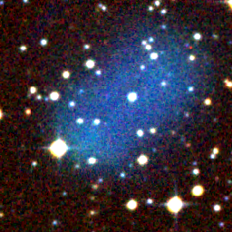
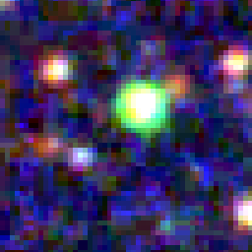
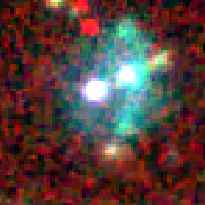
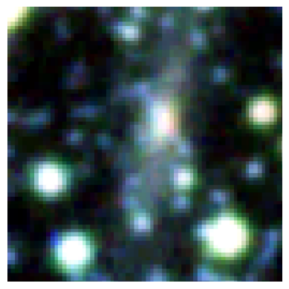
Data
Source: HASH-PN database (Parker, et. al., 2016)
Over 30,000 Images, 5426 Labeled
Custom Dataset: 1,000 sub-samples from Hash-PN ’Optical’ group subset
3-channel RGB images of varying sizes (> 900 x 900 px) Center-cropped to the Possible PNes at 224 x 224 px

Slide 8
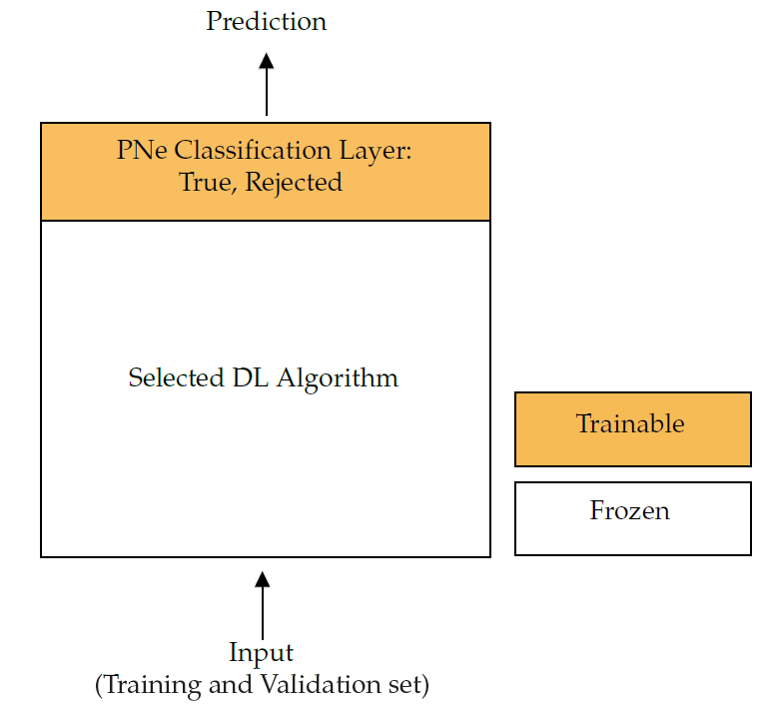
Methods
Reproducibility Study*
Candidate Methods:
Baseline pre-trained models on ImageNet1k
InceptionResNetV2
DenseNet201
ResNet50
Perform Linear Probing on the best performing baseline model*
Perform (possibly Full) Fine-Tuning on the best performing baseline model*
Preliminary Hypothesis:
Fine-Tuning will outperform Baseline and Linear Probing due to large Domain-Shift
*Extensions to Original Paper
Notes:
Mention how Original paper did not do any LP or FT - hence our work will be an extension to this.

Slide 9
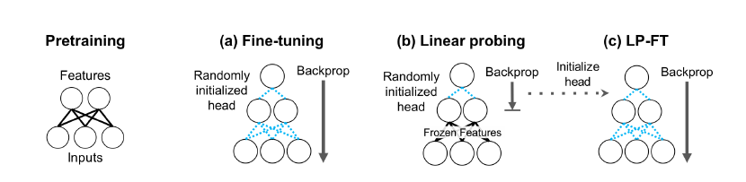
Methods: LP-FT (Transfer Learning)
Baseline (Reproduce): Linear Probing on DenseNet201 pre-trained on ImageNet-1k (Iskandar et. al., 2020)
Ours (Extension):
Perform Fine Tuning (LP-FT) on Baseline (Kumar et al., 2022)
Explore 3 and 5 “top-layer” tuning
Possibly Better Task Adaptation (Fine-tuning refines the model layers to align with the target task)
Higher Risk of Overfitting & Increased Computational Cost

Slide 10
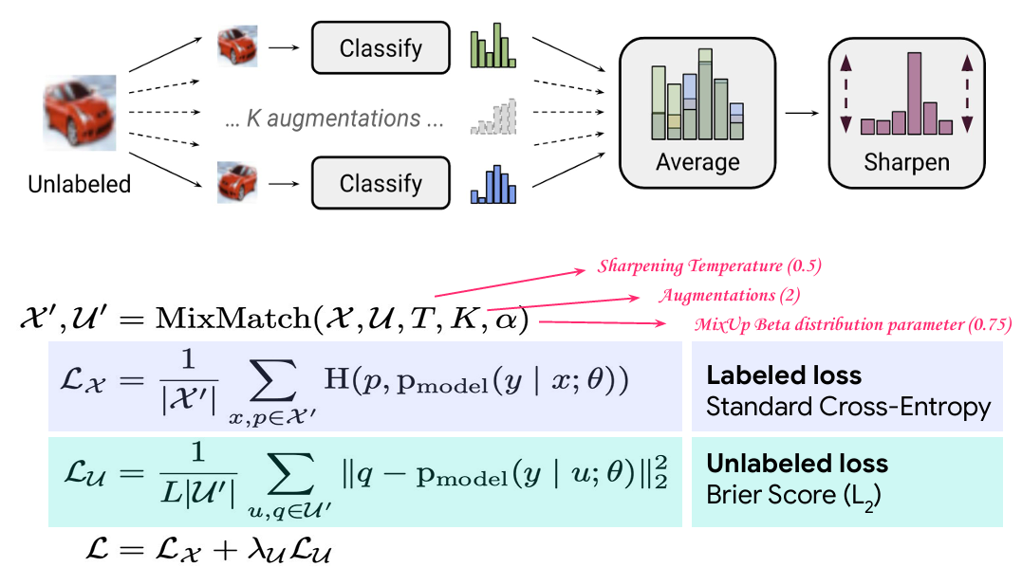
Methods: MixMatch Pseudolabeling (SSL)
MixMatch (Berthelot et al)
Guesses low-entropy and high-consistency labels for the unlabeled examples
Mixes the unlabeled data with labeled examples using MixUp functions .
Flexible to different model
Simple to implement
Reliance on augmentation
Computational overhead

Slide 11
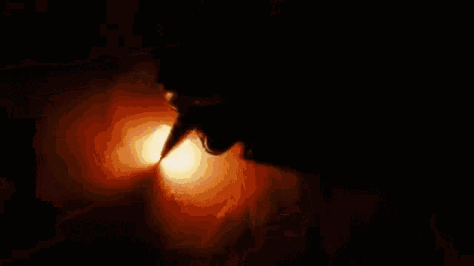
Metrics & Hypothesis
Metrics:
Accuracy - Our goal is to accurately predict True vs Rejected PNes
Hypothesis:
LP-FT will outperform baseline LP and MixMatch in classification accuracy
Factors:
FT refines feature extraction towards our target task
MixMatch’s reliance on consistency regularization of different perturbations (can it effectively learn discriminative representations from our specific dataset?)

Slide 12
Metrics & Hypothesis
Metrics:
Accuracy - Our goal is to accurately predict True vs Rejected PNes
Precision - NEED TO ADD
Recall - to keep track of our dataset balance
Hypothesis:
LP-FT will outperform baseline LP and MixMatch in classification accuracy
Factors:
FT refines feature extraction towards our data
MixMatch’s reliance on consistency regularization of different perturbations

Slide 13
Brief Evaluation Plan
Data Split: Train, Validation, Test (8:1:1 Split)
Avoiding Data Leakage
Ensured no images from the same region of the sky appeared in multiple splits through unique celestial coordinates
Hardware & Compute Resources used
Tufts HPC w/ A100 GPU, ~10 hours for Hyperparameter search (excluding experimentations)

Slide 14
Results
Method | Classification Accuracy on Test set (%)
Baseline (Iskandar et. al.) | 86.0
Baseline (Ours) | 88.0
LP-FT, 5 Top-Layers (Ours) | 84.4
LP-FT, 3 Top-Layers (Ours) | 84.0
MixMatch (Ours) | 78.0
Hypothesis: LP-FT > LP, MixMatch in classification accuracy
Key Observations:
Baseline Results Reproducible
LP-FT outperforms MixMatch
LP-FT did not outperform Baseline (Signs of Overfit, Low-Res Image Challenges)

Slide 15
Reflection and Outlook
Limitations & Future Work:
Low Resolution & Possible Overfitting to Artifacts
Investigate Augmentations on Dataset, Goal: Reduce artifacts/Enhance image features
Investigate effective Feature transfer methods from High-Res to Low-Res
Dataset Limitation for MixMatch
Brief experiment suggests performance increase with more unlabeled data exposure
Hyperparam search suggests even lower unlabelled data loss weight = increased accuracy
Something along the lines of our dataset being niche and therefore results from paper we’ve read are not necessarily reproducible with our limited data
Our experiment highlights that the niche and limited nature of our dataset introduces challenges that make it difficult to directly reproduce results from studies leveraging ImageNet-scale data, underscoring the need for tailored methods and evaluations in specialized domains.

Slide 16
Reflection and Outlook
Limitations & Future Work:
Low Resolution & Possible Overfitting to Artifacts
Investigate more extensive Image Augmentations, Goal: Reduce/Remove artifacts & Enhance image features
Investigate effective Feature transfer methods from High-Res to Low-Res
Lack of Unlabeled data for MixMatch
Brief experiment suggests performance increase with more unlabeled data exposure
Hyperparam search suggests even lower unlabelled data loss weight = increased accuracy
Take-home lesson:
Seem to have reached limits of our existing (vanilla) limited-labeled dataset
No immediate plans to continue for publication
Notes:
At the outset, we deliberately worked with a much smaller dataset compared to the one used in the original research paper. Our hope was to achieve similar—or even better—results by applying the methodologies learned in this class, and to take a different approach from the original authors. However, reality quickly set in, and we ran into the limitations of having too little labeled data. Despite this, we remain confident that, with more time, we can still extract more accuracy from our limited dataset

Slide 17

Challenges
No Public code availability (but simple & straightforward methodology)
Action: Write preliminary code and identify possible blockers/deviations from source.
Attempted: Contact Authors
Bulk Dataset Access (No API) and cumbersome Interface
Action: Better familiarization of Interface and initial scrapping attempt.
Notes:
No code for data preprocessing b/c not all of the images are of the same size so we’ll have to do some data preprocessing to
No code for data scrapping or collection
Mentioned about PLAN-STARSS
If we go with PLAN-STARSS, no label -> have to find a way to map the label from HASHDB over.

Slide 18
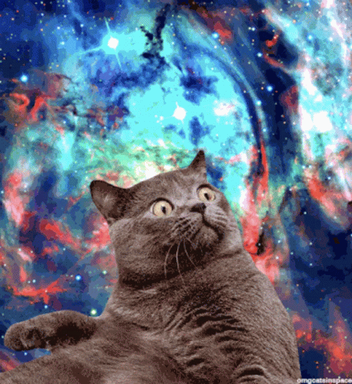
Questions?
Notes:
Can you explain more about mixmatch? Walk us through it.

